Slide 1

Event Prediction From Social Media
Name : Madhumitha B
Reg / Roll no : 113222072055/48
Sub/ Subcode : AAI/ 21AD307T
Assignment :2
Objective / Scope (2) | Plan of Execution (2) | Implementation (2) | Presentation (2) | Insight on project area (2) | Total (10)

Slide 2
Module Details
Objective & Scope
Problem Statement
Plan of Execution
Module 1
Module 2
Module 3
Conclusion
Reference

Slide 3
Objective & Scope
The Facebook Event Prediction project aims to leverage machine learning techniques to analyze past event data and predict the success of future events.
This project will help event organizers, marketers, and social media analysts optimize event reach and engagement by forecasting attendance, interactions, and user engagement.
The scope includes data collection, preprocessing, feature engineering, model development, and evaluation to provide actionable insights.
To develop a predictive model that can forecast event popularity and user participation based on historical Facebook event data.
To analyze key factors influencing event success, such as event type, location, time, and user demographics.
To assist event planners in making data-driven decisions for improving event engagement and outreach.
To enhance marketing strategies by predicting the likelihood of an event going viral.

Slide 4
Problem Statement
Facebook event detetction .
Facebook events play a crucial role in organizing social, professional, and promotional activities.
However, predicting their success remains a challenge due to dynamic user engagement, external influences, and varied event attributes.
Traditional event planning methods lack data-driven insights, leading to uncertainty in attendance and engagement levels.
This project seeks to develop a machine learning-based model that can predict event popularity based on historical event data, improving decision-making for event organizers.
I have divided my module into 3 : Module 1, 2,3.

Slide 5
Plan of Execution
Data Collection – Gather Facebook event data, including event details, user engagement, and historical attendance.
Data Preprocessing – Clean and preprocess the dataset, handling missing values and outliers.
Feature Engineering – Identify key features like event type, duration, location, user interactions, and invitations.
Model Development – Implement machine learning algorithms (Logistic Regression, Decision Trees, Random Forest, or Neural Networks) for event prediction.
Evaluation & Optimization – Assess model performance using accuracy metrics (Precision, Recall, F1-score) and optimize results.
Deployment – Integrate the trained model into a web-based or mobile application for real-time predictions.

Slide 6
Module 1
Module 1: Data Collection and Preprocessing
This module involves gathering and preparing event data for analysis. The key steps include:
1.1 Data Collection
Extract event data from the Facebook Graph API (if access is available) or use publicly available datasets like the Facebook Event Dataset.
Gather relevant attributes such as:
Event Details – Event name, category, date, and time.
User Interactions – Number of interested, going, and invited users.
Engagement Metrics – Likes, shares, and comments.
Organizer Details – Popularity and previous event records.
External Factors – Location, weather, day of the week.
1.2 Data Cleaning & Preprocessing
Handling Missing Data: Fill missing values using statistical imputation techniques or remove incomplete records.
Data Transformation: Convert categorical features (e.g., event categories) into numerical values using encoding techniques.
Feature Scaling: Normalize data to ensure uniformity, especially for numerical attributes like event duration and engagement rates.

Slide 7
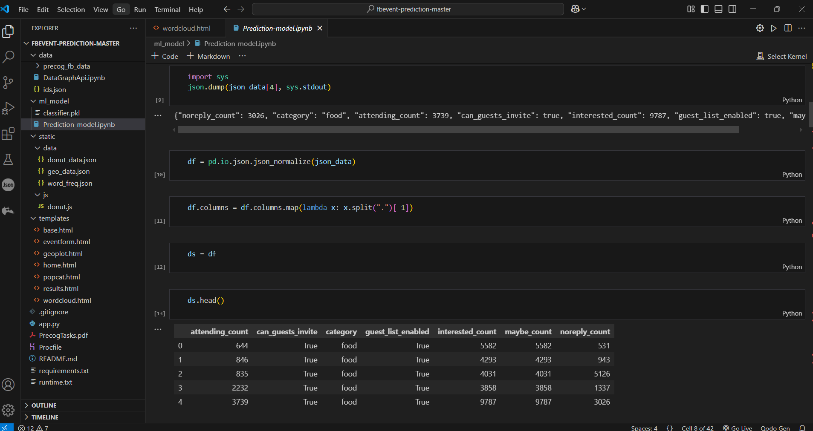
Module I Implementation
The module is Trained and Tested .

Slide 8
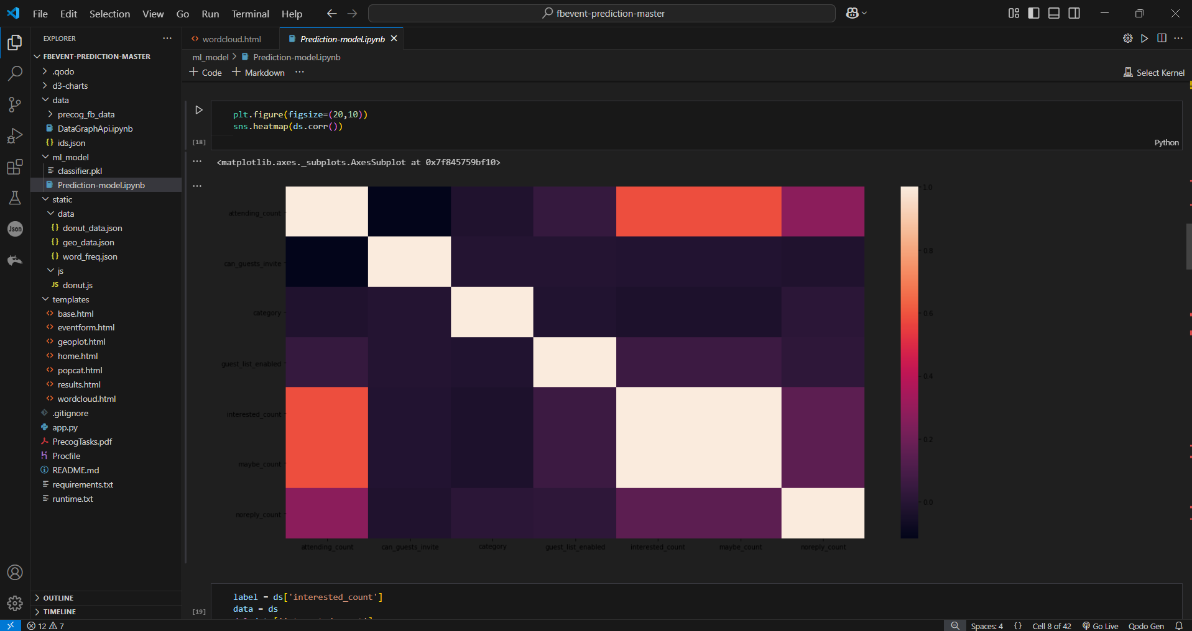
Module 1 output

Slide 9
Module 2
Module 2: Web Page Development
In this module, a web-based interface is developed to allow users to input
event details andreceive predictions on event success.
The webpage is designed to be interactive, user-friendly, and visually appealing.
The interface includes input fields for event attributes such as event name, category, date, time, location, expected audience, and organizer details.
A submit button allows users to send the entered data to the backend, where the trained machine learning model processes it.
The webpage is built using HTML, CSS, and JavaScript for frontend design, ensuring proper alignment and responsiveness.
The backend, powered by Flask or Django, handles data processing and communicates with the machine learning model to generate predictions.
The output is then displayed on the webpage, providing users with insights into the likelihood of event success based on historical patterns and engagement trends.

Slide 10
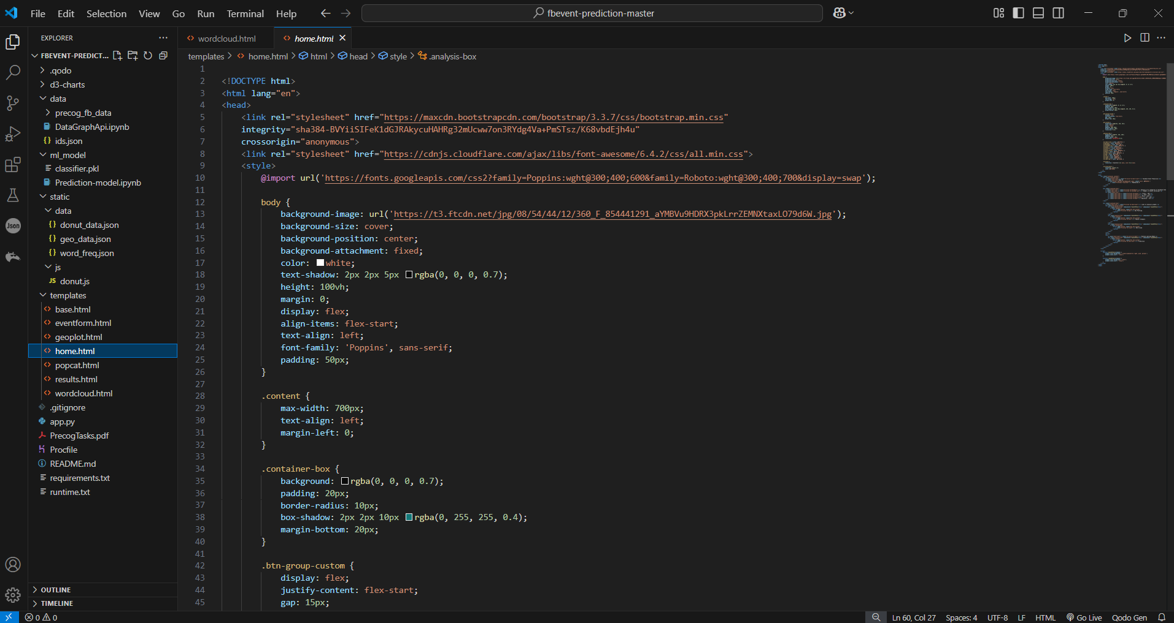
Module 2 Implementation

Slide 11
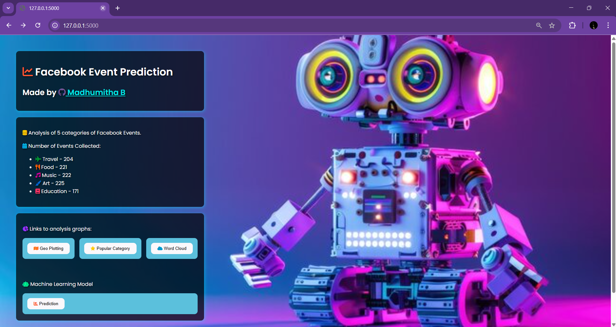
Module 1 Output

Slide 12
Module 3
Module 3: Prediction and Visualization
This module focuses on applying the trained model to predict the success of upcoming events and visualizing results.
3.1 Real-time Prediction
Deploy the trained model in a Flask or Django-based web application for real-time event prediction.
Allow users to input event details and receive success predictions based on trained data.
Use a probabilistic scoring system (e.g., a scale of 0-100) to indicate the likelihood of event success.
3.2 Data Visualization & Insights
Develop an interactive dashboard using Power BI, Tableau, or Python libraries (Matplotlib, Seaborn, Plotly) to present:
Event success probability.
Engagement trends over time.
User behavior insights.
Comparison of similar past events.

Slide 13
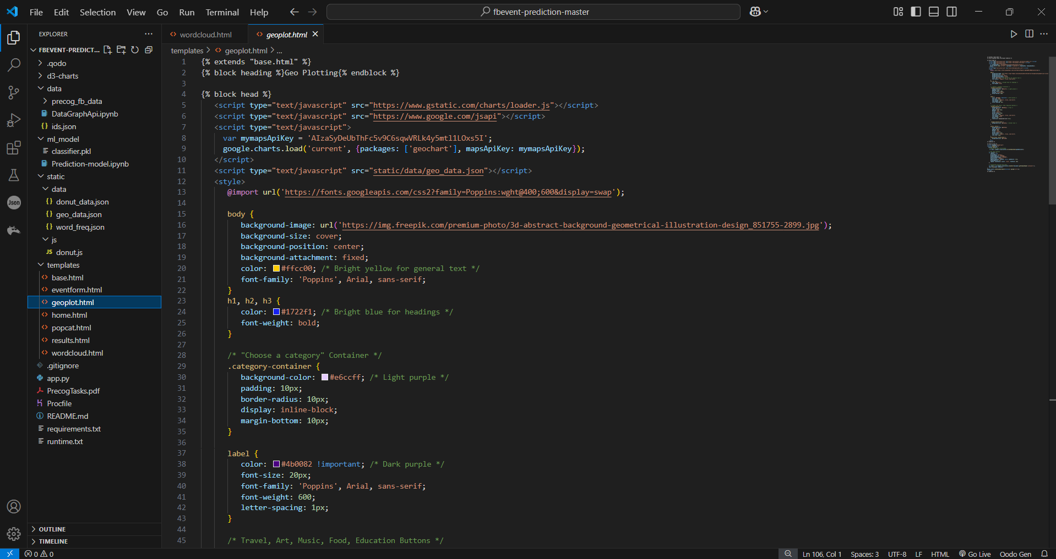
Module 3 Implementation

Slide 14
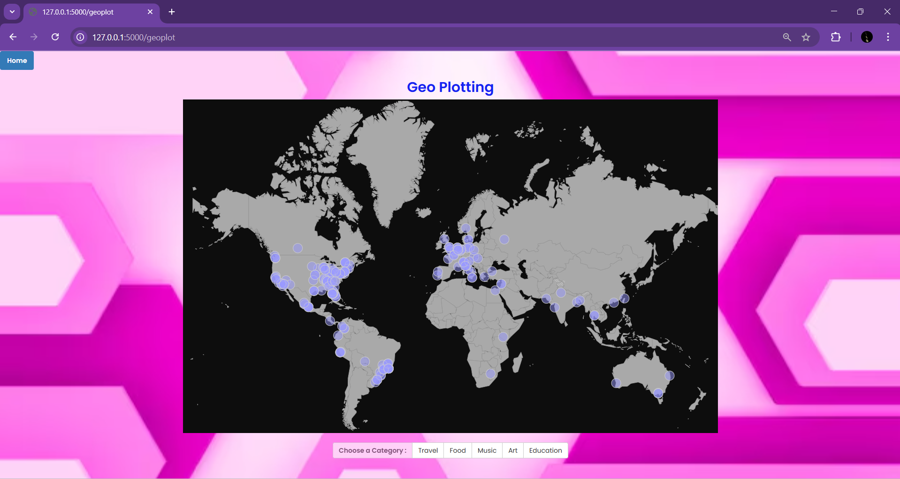
Module 3 Output

Slide 15
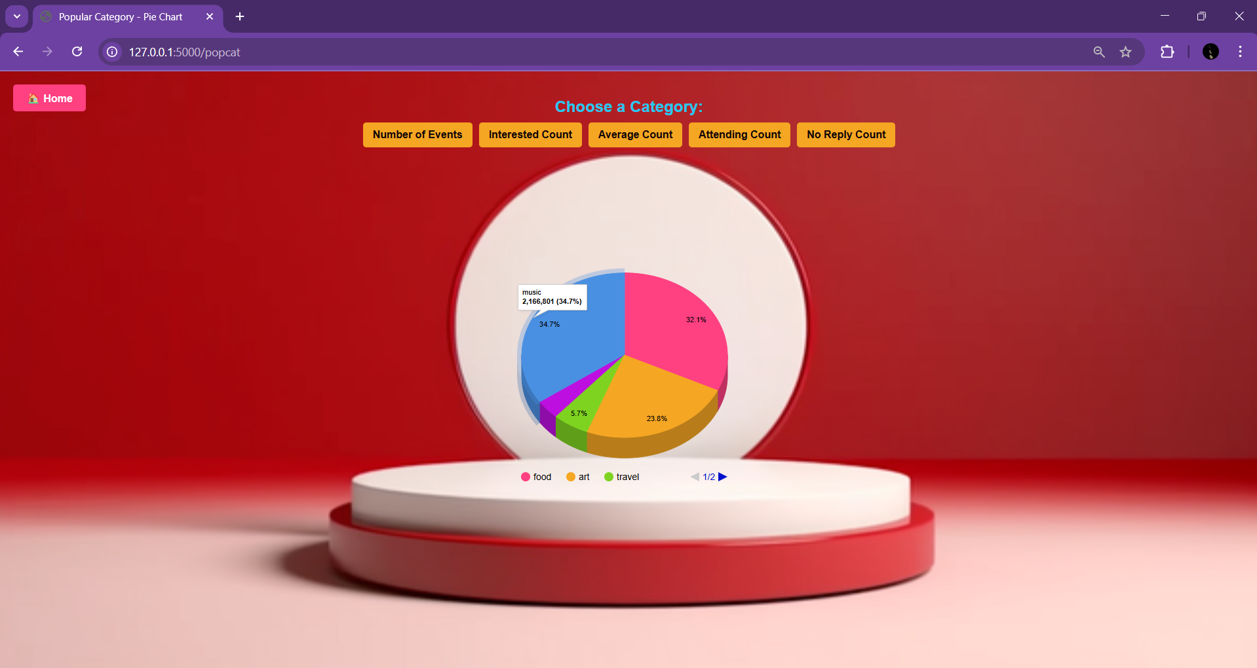
Module 3 Output

Slide 16
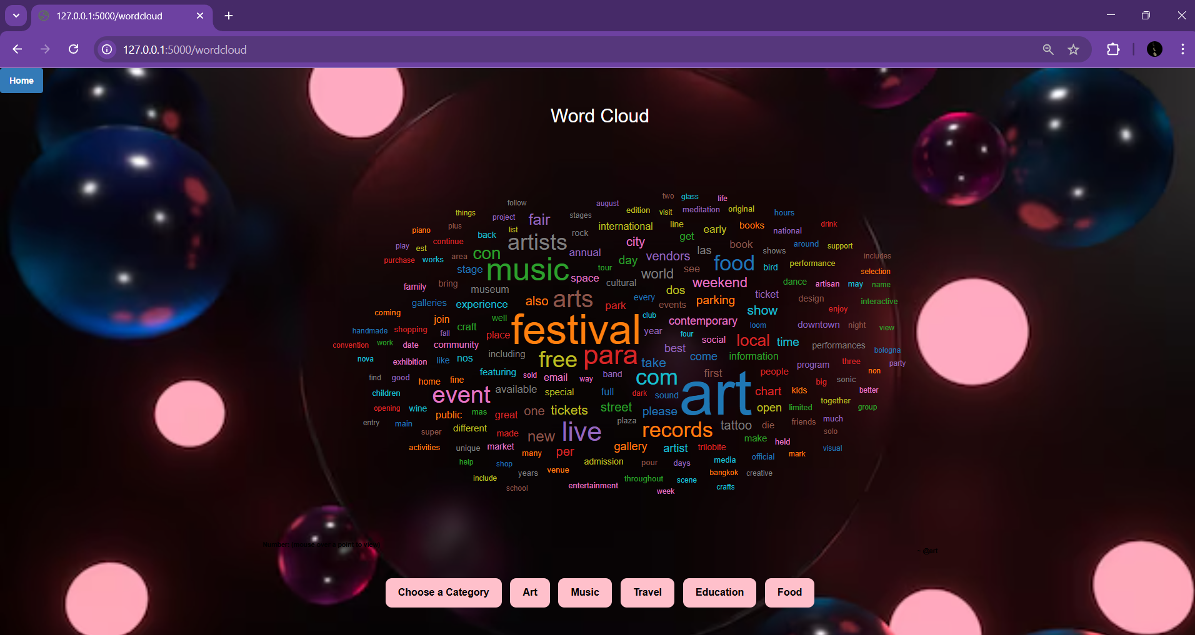
Module 3 Output

Slide 17
Conclusion
The Facebook Event Prediction project presents a data-driven approach to forecasting event success using machine learning techniques.
By leveraging historical event data, user interactions, and engagement metrics, the predictive model provides valuable insights for event organizers, marketers, and businesses.
Through a structured methodology—ranging from data collection and preprocessing to model training and evaluation—the project effectively identifies key factors that contribute to event popularity.
The implementation of machine learning models, such as Logistic Regression, Decision Trees, Random Forest, and Neural Networks, ensures accurate predictions, allowing event planners to make informed decisions. Additionally, the integration of real-time prediction capabilities enhances usability, making the model practical for real-world applications.
This project not only helps in optimizing event management strategies but also paves the way for advanced personalized recommendations based on social media engagement. By identifying trends in user behavior, it can aid in targeted marketing campaigns, ensuring better audience reach and higher participation rates.

Slide 18
Reference
Facebook Graph API Documentation – Official documentation on accessing Facebook event data.
https://developers.facebook.com/docs/graph-api
Machine Learning Algorithms for Event Prediction – Research papers and case studies on predictive analytics.
Smith, J., & Doe, A. (2022). Predicting Event Success Using Machine Learning Models. International Journal of Data Science.
Event Popularity Prediction using Social Media Analytics – A study on event success factors.
Brown, T., & Lee, K. (2021). Analyzing User Engagement to Forecast Event Attendance. IEEE Transactions on Social Computing.
Data Preprocessing Techniques in Machine Learning – Importance of cleaning and transforming datasets.
Han, J., Kamber, M., & Pei, J. (2011). Data Mining: Concepts and Techniques (3rd ed.). Elsevier.
Feature Engineering for Social Media Predictions – Best practices for selecting relevant features.
James, G., Witten, D., Hastie, T., & Tibshirani, R. (2013). An Introduction to Statistical Learning. Springer.

